Slide 6
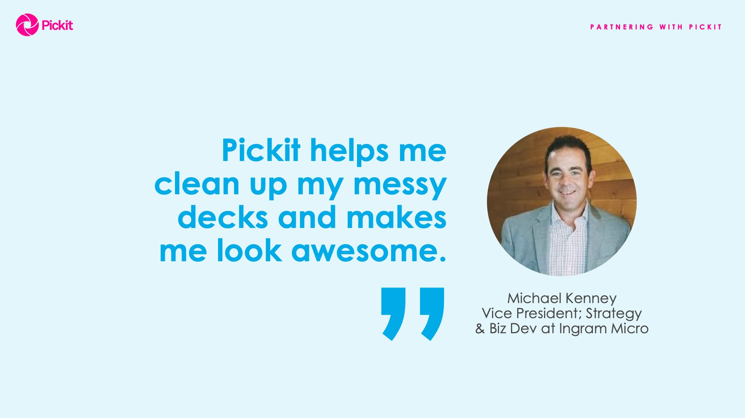

Slide 15
See Microsoft CEO, Satya Nadella, highlight Pickit at Build
https://youtu.be/ftFdW4YZZiU?t=1m17s
Hear Microsoft Corporate VP, Gavriella Schuster, feature Pickit in her keynote at Inspire
https://vimeo.com/280445078#t=1255s

